Slide 1
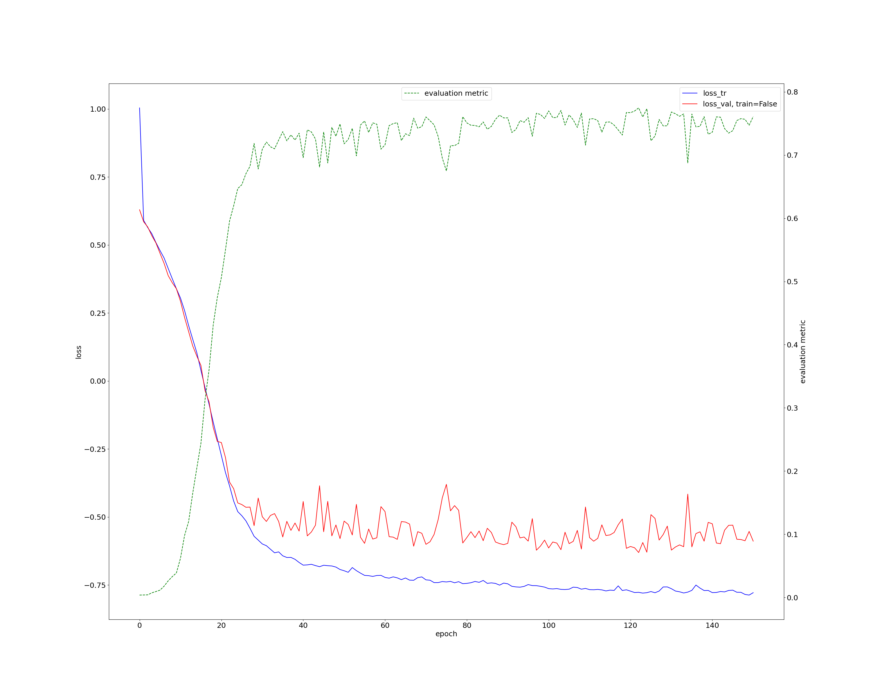
nNUnet on MICCAI

Slide 2
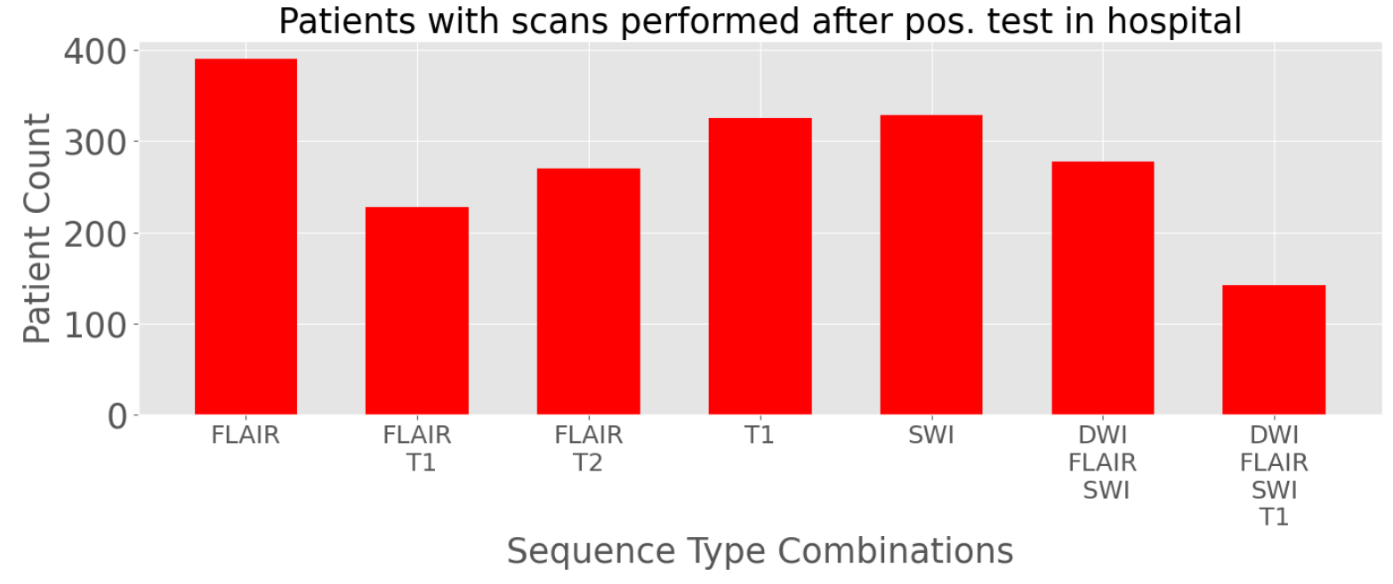
Notes:
WML: FLAIR, T2 or both
Microbleeds: SWI recommended (T2* also possible but no preferred, also not present for the pos patients)
Microbleeds CRB (DWI, FLAIR, SWI)

Slide 3
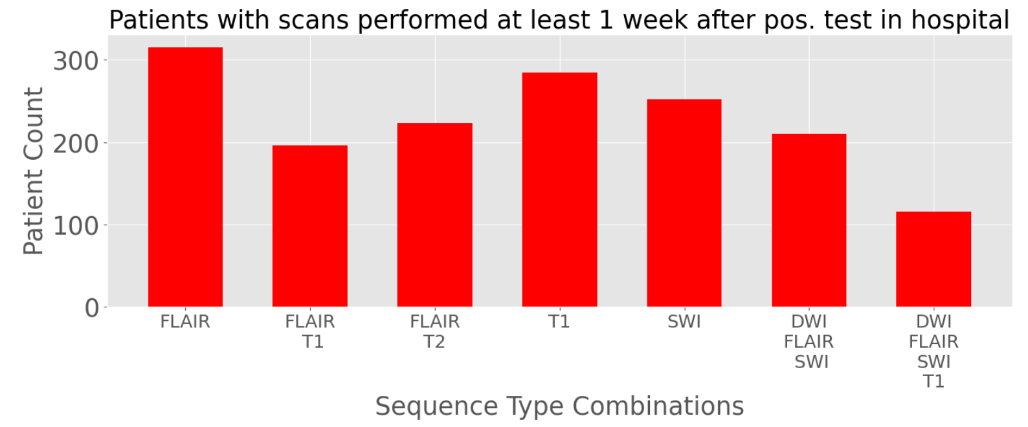
Notes:
WML: FLAIR, T2 or both
Microbleeds: SWI recommended (T2* also possible but no preferred, also not present for the pos patients)
Microbleeds CRB (DWI, FLAIR, SWI)

